Slide 1





Automated Segmentation of 3D Electron Microscopy Images
Joris Roels
Notes:
Thank you Mr. Chairman for the kind introduction. Dear members of the examination board, dear colleagues, friends and family. I would like to welcome you and thank you for coming.

Slide 2
2.09 million
1.76 million

Slide 3
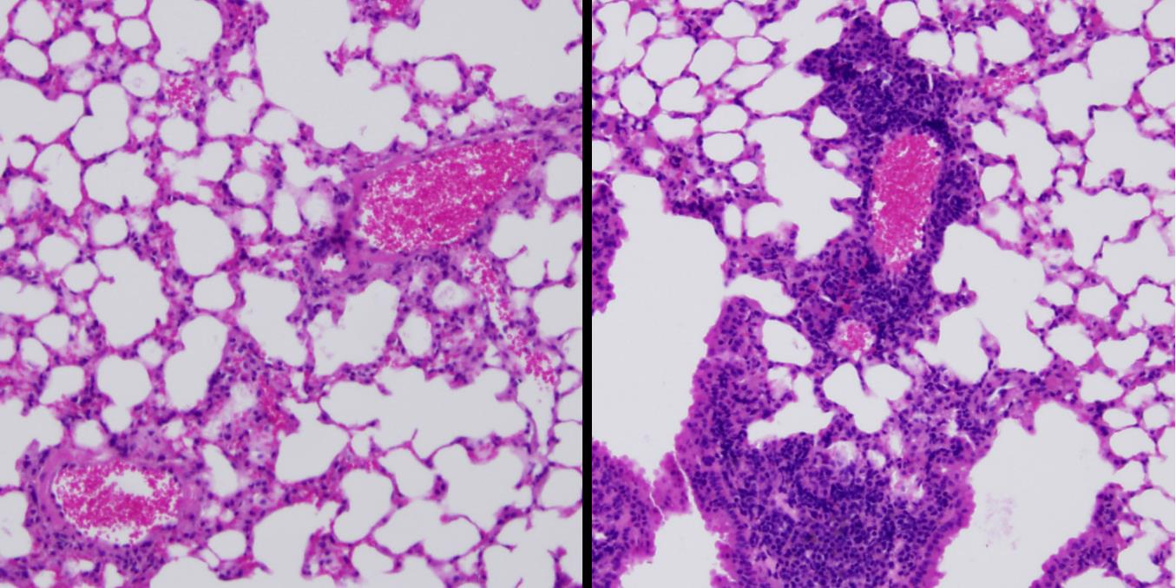
Lung cells under the microscope
Healthy cells
Cancer cells

Slide 4
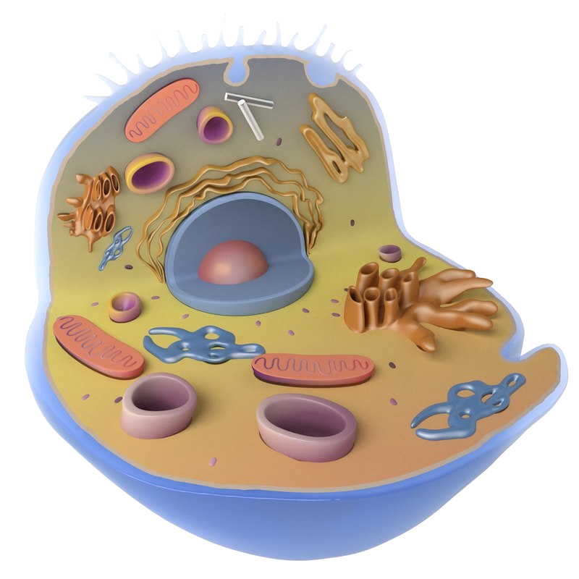
Potential cause for lung cancer
Mitochondria: energy generators
Endoplasmic reticulum (ER): transportation network
Cells receive too much energy
Cells become bigger
Number of cells increases

Slide 5

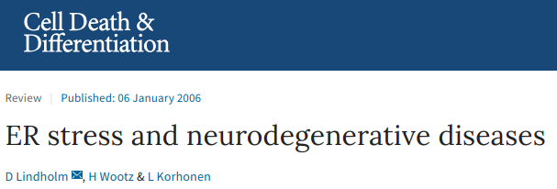
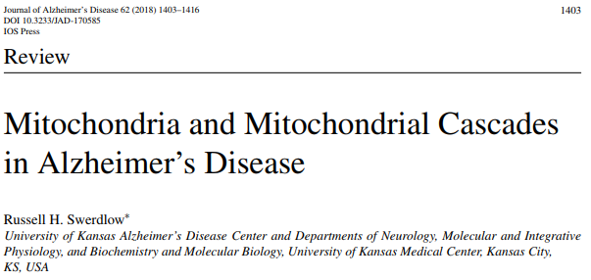

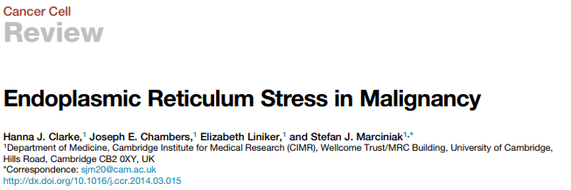
Life science research
Growing interest in analysis mitochondria & ER:
Alzheimer’s disease
Parkinson’s disease
Dementia
Cancer
…

Slide 6
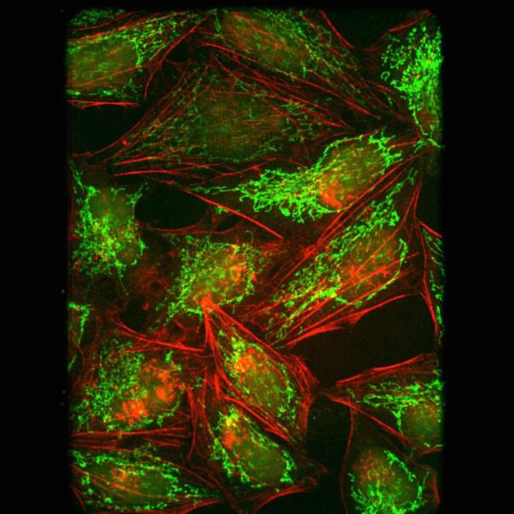

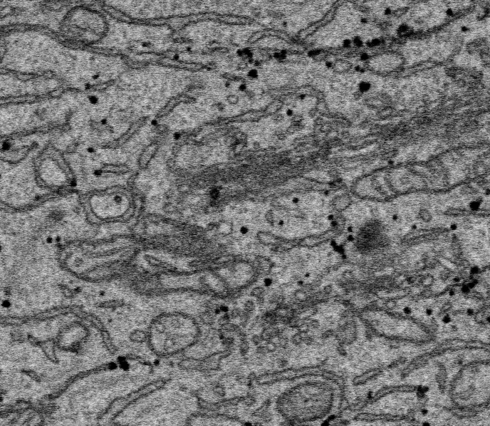
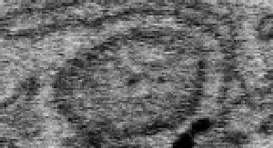
Problem statement
Visualisation of mitochondria & ER is difficult
Light microscopy
Noise
Blur
Electron microscopy

Slide 7
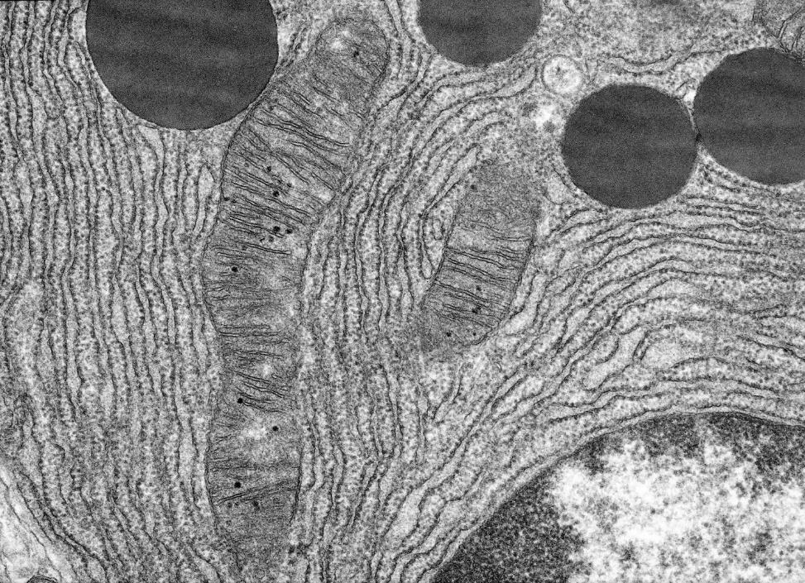
Problem statement
Quantitative analysis of mitochondria & ER is even more difficult
Measure total ER volume?
How many contact points with mitochondria?
…

Slide 8
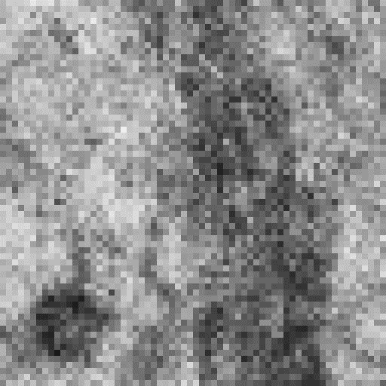
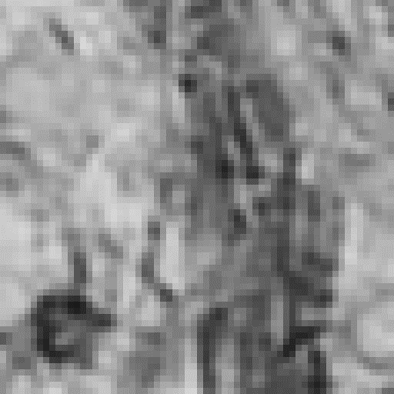
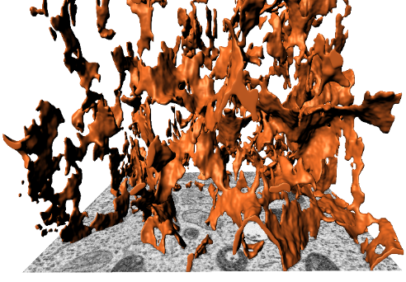
Outline
Introduction to 3D electron microscopy (EM)
Image restoration in 3D EM
Noise & blur analysis
NLM-SC
PV-DEC
Image restoration in practice: DenoisEM
Image segmentation in 3D EM
Ensemble networks
Towards less expert intervention: weak annotations
Segmentation of new data: domain adaptation
Conclusion

Slide 9
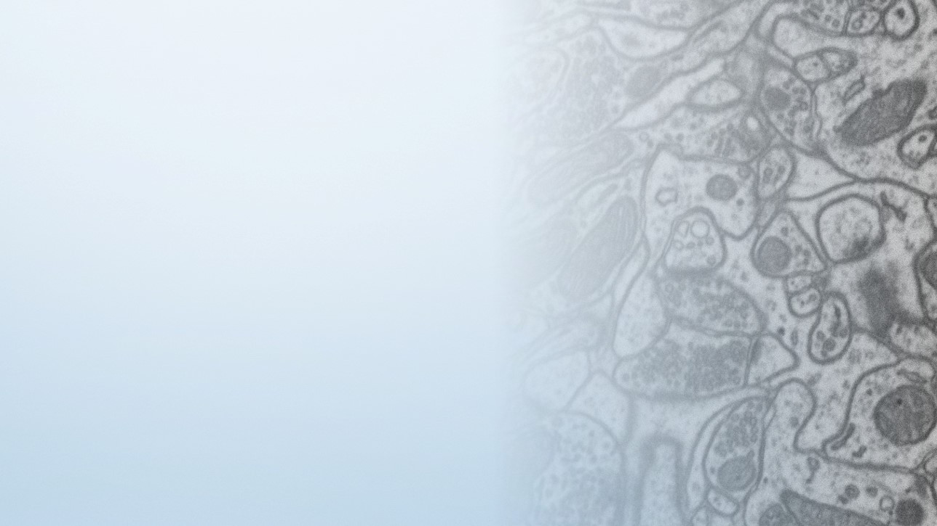
Introduction to 3D electron microscopy

Slide 10
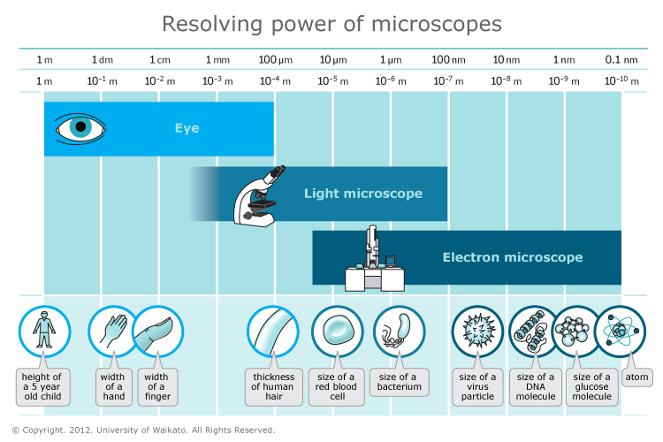
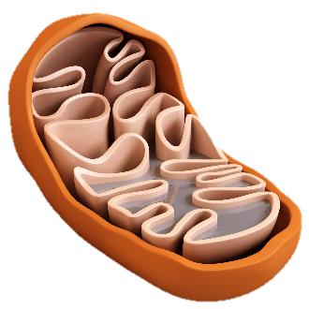
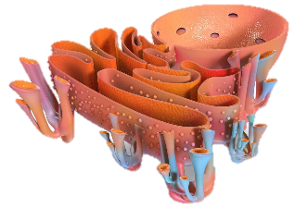
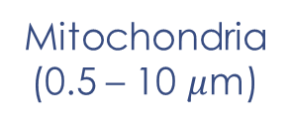
The need for high resolution imaging
Mitochondria
(0.5 – 10 $μ$m)
ER sheets
(10 – 50 nm)

Slide 11
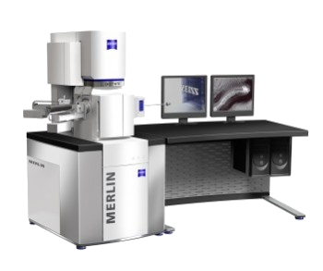
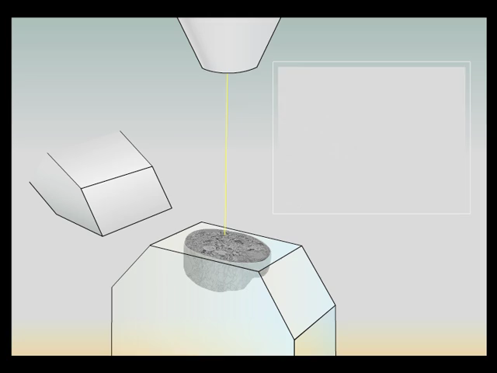
3D EM imaging
2D imaging with an electron beam
Sectioning with a diamond knife

Slide 12
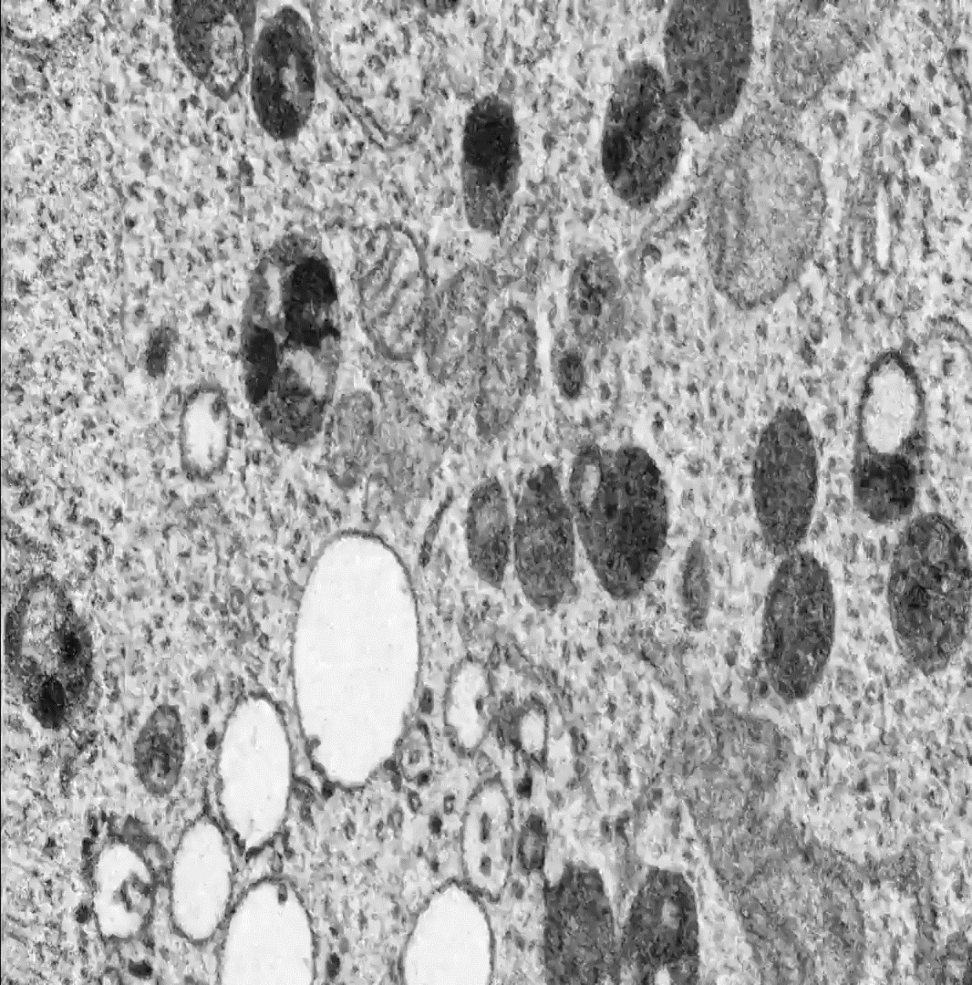
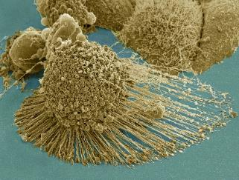
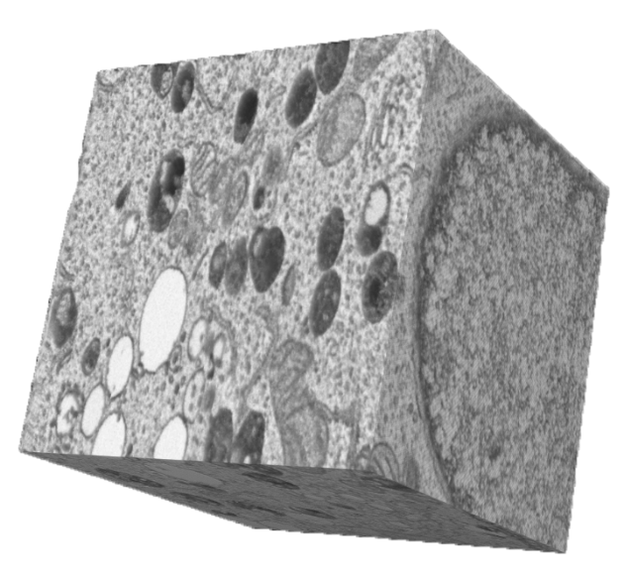
3D EM data
HeLa cell

Slide 13
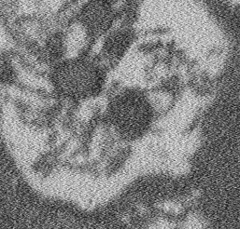
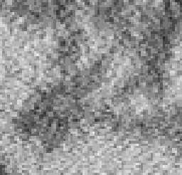
Degradations in EM imaging
Noise
Blur

Slide 14
Outline
Introduction to 3D electron microscopy (EM)
Image restoration in 3D EM
Noise & blur analysis
NLM-SC
PV-DEC
Image restoration in practice: DenoisEM
Image segmentation in 3D EM
Ensemble networks
Towards less expert intervention: weak annotations
Segmentation of new data: domain adaptation
Conclusion

Slide 15
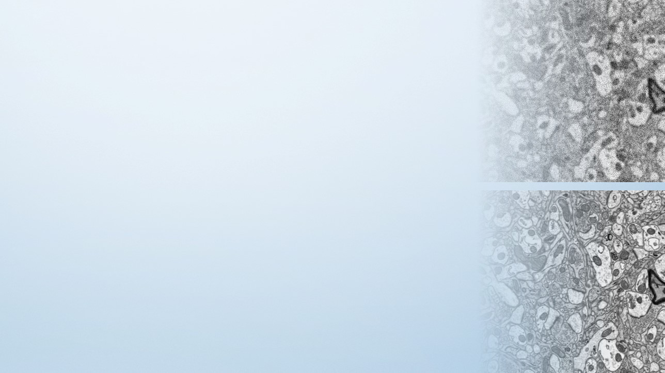
Image restoration in 3D EM

Slide 16

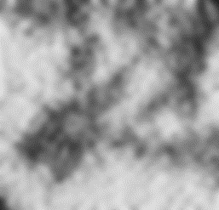
EM image restoration: how it is currently done
Gaussian filter:
➔ Average pixels locally to denoise the reference pixel
Blur introduction along edges
Acquired image
Restored image

Slide 17
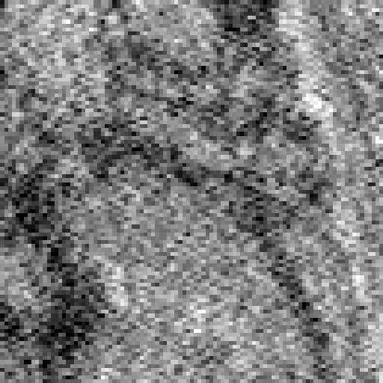
Non-local means (NLM)
For each pixel:
Find (non-local) similar regions
Compute weights for each region:
Similar region ➔ high weight
Dissimilar region ➔ low weight
Restore pixel by weighted averaging
0.05
0.35
0.60

Slide 18
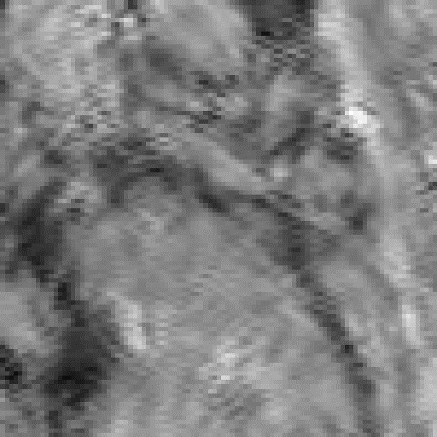
NLM: results
Degraded image
NLM

Slide 19
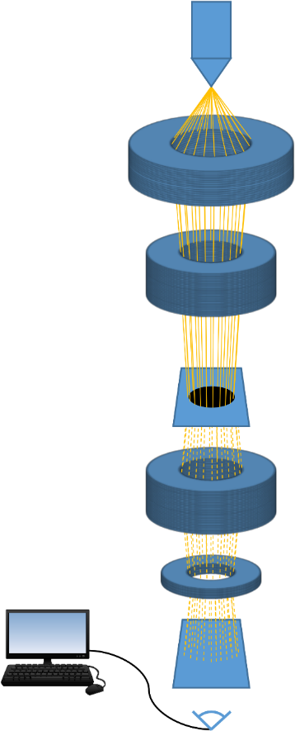
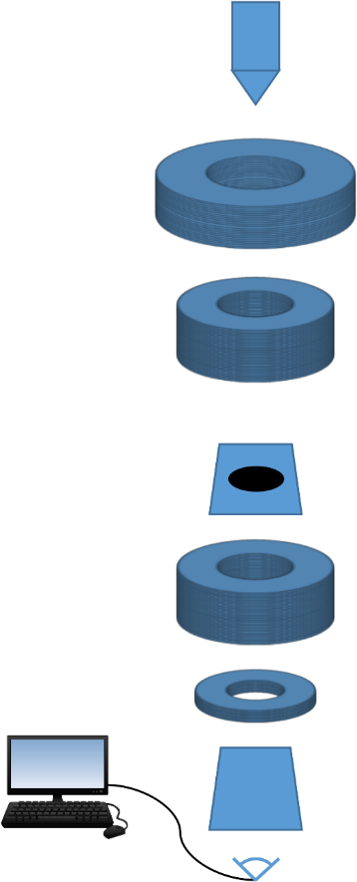

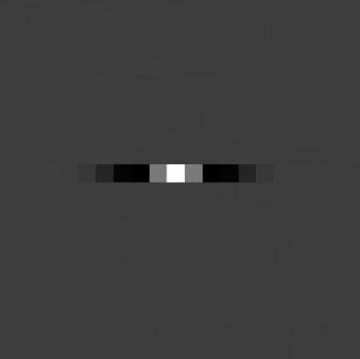
Noise estimation
Switch off the electron beam (“take a picture in a dark room”)
➔ Noise signal
Noise correlation model

Slide 20


Proposed method: NLM-SC
Noise correlation model
Noise prewhitening: undo the correlation
Compute weights on the prewhitened image
Inversion
0.10
0.30
0.70

Slide 21
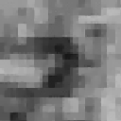
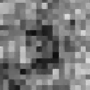
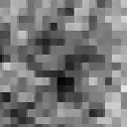
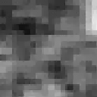
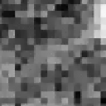
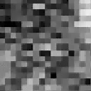
Proposed method: NLM-SC
Prewhitening improves window comparison
Degradation-free
No prewhitening
Prewhitening

Slide 22
Results
PSNR
(dB, higher is better)
Noise level

Slide 23

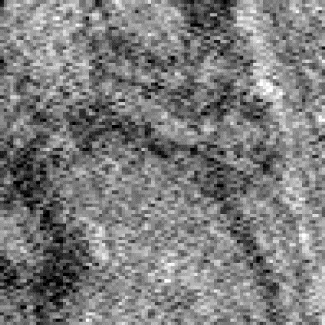


Results
Ground truth
Degraded image
Gaussian filter
NLM
NLM-SC (proposed)

Slide 24

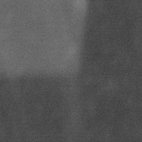
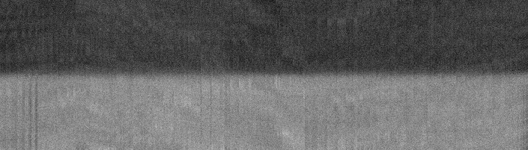
Blur estimation
Acquire binary samples that should have crisp edges
1D edge extraction

Slide 25
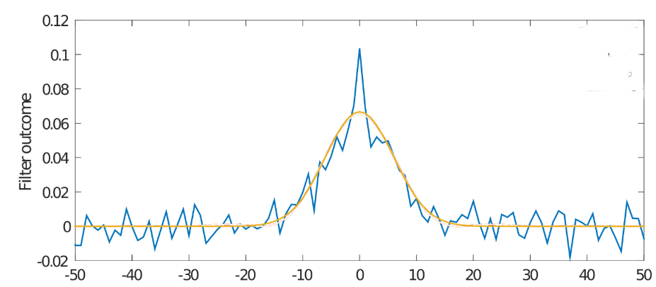

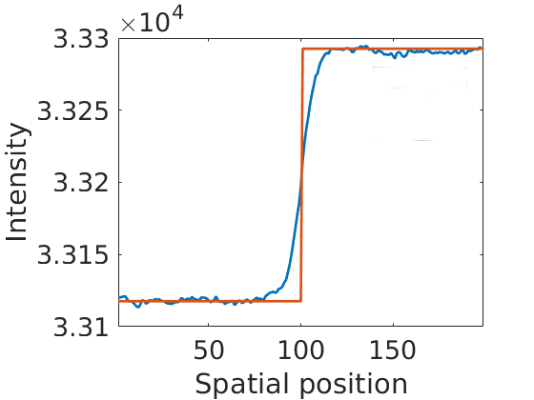
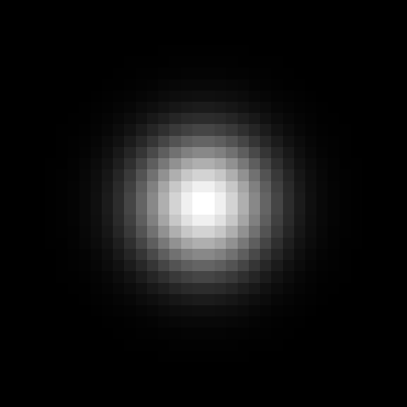
Blur estimation
Estimate a 1D kernel from the measured edge signals
Measured kernel
Fitted kernel
Averaging
Inversion
Radial symmetry
Measured signal
True signal

Slide 26
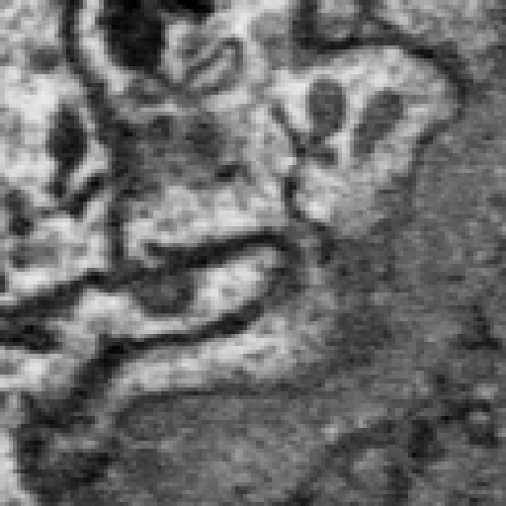
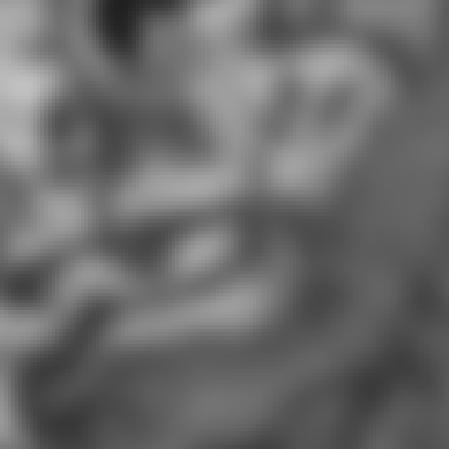

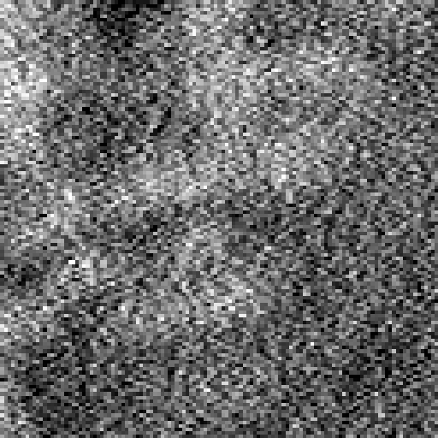
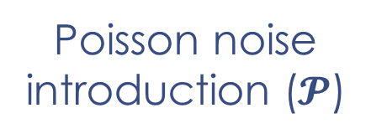

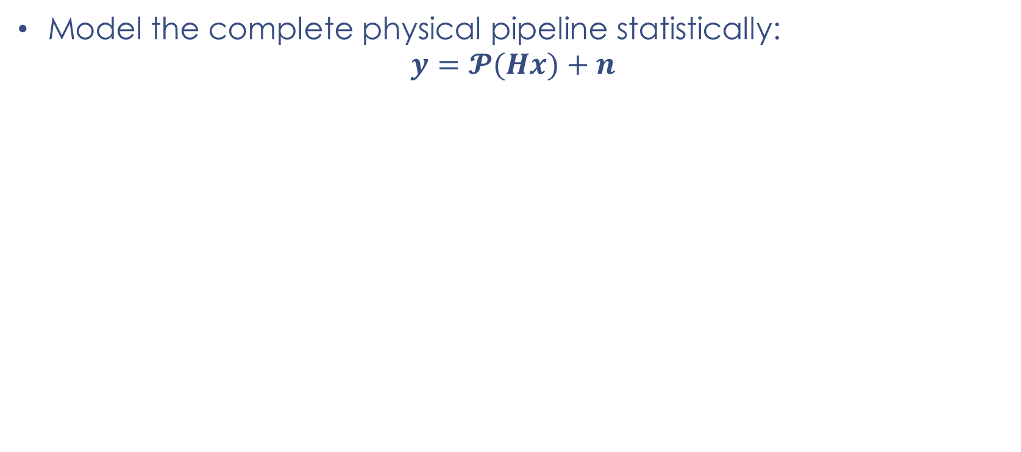

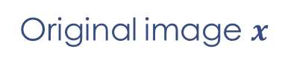
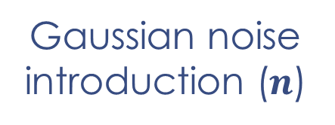
Primal-variational deconvolution (PV-DEC)
Model the complete physical pipeline statistically:
$$y=𝓟(Hx)+n$$
Original image $x$
Acquired image $y$
Blur introduction ($H$)
Poisson noise introduction ($𝓟$)
Gaussian noise introduction ($n$)
Imperfect magnetic lenses, focusing
Sensor counting errors
Electromagnetical interference

Slide 27

Primal-variational deconvolution (PV-DEC)
Model the complete physical pipeline statistically:
$$y=𝓟(Hx)+n$$
Introduce the image without Gaussian noise: $p=𝓟(Hx)$
What pair $\left(\hat{x},\hat{p}\right)$ would make $\hat{x}$, $\hat{p}$ and $y$ the most likely acquired image?
$$\left(\hat{x},\hat{p}\right)=arg \max_{(x,p)}{f(x,p,y)}$$
$=arg \min_{(x,p)}{ ℒ_{G}\left(y−p\right)+ℒ_{P}\left(p;Hx\right)+λℒ_{X}(x)}$

Slide 28

Primal-variational deconvolution (PV-DEC)
Model the complete physical pipeline statistically:
$$y=𝓟(Hx)+n$$
Introduce the image without Gaussian noise: $p=𝓟(Hx)$
What pair $\left(\hat{x},\hat{p}\right)$ would make $\hat{x}$, $\hat{p}$ and $y$ the most likely acquired image?
$$\left(\hat{x},\hat{p}\right)=arg \max_{(x,p)}{f(x,p,y)}$$
$=arg \min_{(x,p)}{ ℒ_{G}\left(y−p\right)+ℒ_{P}\left(p;Hx\right)+λℒ_{X}(x)}$
Does this image have a Gaussian distribution?
Does this image have a Poisson distribution?
How likely is this image?

Slide 29


Sparsity as a prior
Transform the image to an alternative representation that should be sparse
Wavelet transform
Inverse wavelet transform

Slide 30
Results
PSNR
(dB, higher is better)
Noise level

Slide 31



Results
Ground truth
Degraded image
Gaussian filter
NLM-SC
PV-DEC (proposed)

Slide 32





The importance of parameters
$$λ$$
How do we tune parameters to optimality as fast as possible?

Slide 33





DenoisEM: introducing the human in the loop
GPU accelerated backend

Slide 34



DenoisEM

Slide 35
Outline
Introduction to 3D electron microscopy (EM)
Image restoration in 3D EM
Noise & blur analysis
NLM-SC
PV-DEC
Image restoration in practice: DenoisEM
Image segmentation in 3D EM
Ensemble networks
Towards less expert intervention: weak annotations
Segmentation of new data: domain adaptation
Conclusion

Slide 36

EM Image Segmentation

Slide 37



EM image segmentation: how it is currently done
Manual labeling
➔ Time consuming
$0.001$ mm³
Reconstruction of all neurons required 4 years using 224 grad students

Slide 38



EM image segmentation: how it is currently done
Automated techniques
➔ Insufficient quality
Input
Automatically generated segmentation with current techniques
Ground truth

Slide 39







Classical image segmentation techniques
Extract hand-designed features from data
Intensity
Edges
Texture
Shape
Learn to combine these features to obtain the segmentation based on a set op labeled examples
Which features?

Slide 40



Advanced image segmentation: convolutional neural networks (CNNs)
Compute the segmentation by computing features layer by layer with basic operations (convolution, truncating, maximum, …)

Slide 41








Advanced image segmentation: convolutional neural networks (CNNs)

Slide 42
Advanced image segmentation convolutional neural networks (CNNs)
Feature extraction is “trained” iteratively by looking at labeled examples
Compute segmentation
Optimise parameters
Parameters layer 1
Parameters layer 2
Parameters layer 3

Slide 43


State-of-the-art architectures
Classical CNN
U-Net
FCN

Slide 44


CNN-based segmentation: results
Quality measure:
Intersection(S,GT)
Jaccard =
Union(S,GT)
0.24
0.89
 | Mitochondria | ER
CNN | 0.752 | 0.309
FCN | 0.871 | 0.594
2D U-Net | 0.877 | 0.614
3D U-Net | 0.890 | 0.635

Slide 45


CNN-based segmentation: disadvantages
3D labels are hard to obtain, 2D labels are easier
Too much labeled data required
Networks do not generalise well to new data
Scanning EM
Transmission EM

Slide 46

An ensemble of 2D networks

Slide 47








Results: 2D ensembles
Segmentation & computational performance:
Jaccard | Training time | Testing time
87.74 | 6h 1m 4s | 39s
88.99 | 2d 7h 8m | 5m 13s
88.62 | 8h 14m 39s | 2m 1s
Input + ground truth
U-Net (2D)
U-Net (3D)
Ensemble

Slide 48

Mitochondria segmentation result for 2D ensemble

Slide 49
CNN-based segmentation: disadvantages
3D labels are hard to obtain, 2D labels are easier
Too much labeled data required
Networks do not generalise well to new data
Scanning EM
Transmission EM

Slide 50







Towards less supervision: weak labels
Strong supervision:
High labour intensity
$≈$ 20 seconds / image
Weak supervision:
Low labour intensity
$≈$ 2 seconds / image (image-level)
$≈$ 2 seconds / image (point-level)
$≈$ 4 seconds / image (squiggle-level)
Pixel-level
Image-level
Point-level
Squiggle-level

Slide 51

Object localisation with weak labels
Activation in CNN trained on weak mitochondria labels
Activation in CNN trained on weak ER labels

Slide 52




Weakly supervised pretraining
Pretrain the encoder with lots of weak labels (cheap)
Finetune the complete network with few strong labels (expensive)

Slide 53

Weakly supervised pretraining: results
Weak labels:
0, 512, 2048 annotated images
2 seconds / image
Strong labels
10, …, 100 annotated images
20 seconds / image

Slide 54
CNN-based segmentation: disadvantages
3D labels are hard to obtain, 2D labels are easier
Too much labeled data required
Networks do not generalise well to new data
Scanning EM
Transmission EM

Slide 55







What about new datasets?
Data
Image segmentation
Reconstruction
High-level analysis:
Counting
Volume measuring
Shape modeling
…
?
?
?

Slide 56






Domain adaptation: learning from other labels
Source data
Source labels
Target data
Predictive model
Target prediction

Slide 57


Y-Net: reconstruction-based domain adaptive segmentation
Add a reconstruction decoder for source and target
Feature encoder finds features for source/target reconstruction and source segmentation
Feature encoder
Segmentation decoder
Reconstruction decoder

Slide 58





Y-Net: results
Scanning EM
Transmission EM
Ground truth
No adaptation
Y-Net
 | No DA | Y-Net
Jaccard | 28.70 | 49.55

Slide 59

DA segmentation for the reconstruction of ER

Slide 60





Conclusion
Novel image restoration techniques: recover detailed structures in 3D EM data
DenoisEM: denoising plugin accessible to the life science community
New segmentation algorithms: less manual intervention & better performance
Domain adaptive segmentation: better performance on new datasets
International collaboration

Slide 61
Thank you!

